Slide 1

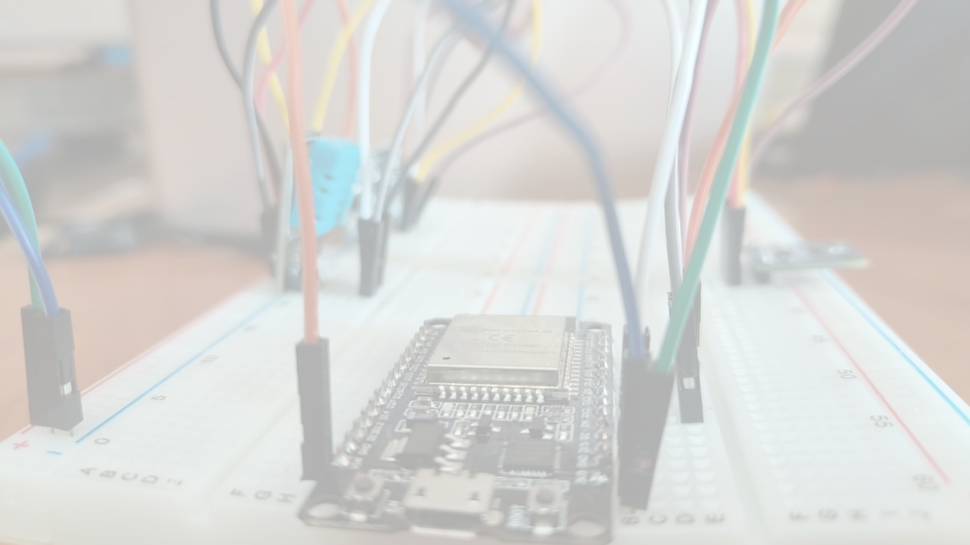
CRITICAL THINKERS
"Education is the key to success"

Slide 2
PROBLEM STATEMENT
It is a common sight that students generally are unable to focus properly in the classroom. In order to prevent this issue and improve the quality of our education system, we have a prototype built for an EFFECTIVE STUDY ENVIRONMENT USING SENSORS WITH AN ENVIRONMENTAL MANAGEMENT SETUP.

Slide 3
INTRODUCTION
The current trends in the IoT and cloud services have resulted in interactive, innovative and automated implementations of smart systems.
While studying, students usually have to deal with an ability to not be able to focus properly in the classroom.
To prevent this issue and improvise our education system in an efficient way, we came up with a solution by setting up a proper study environment for the students in the classroom.
This could be done with the help of IoT, interconnected sensor networks and environmental management system, integrated with the Blynk app.
This helps the students to fully concentrate on their studies and thus increase their overall performance.

Slide 4

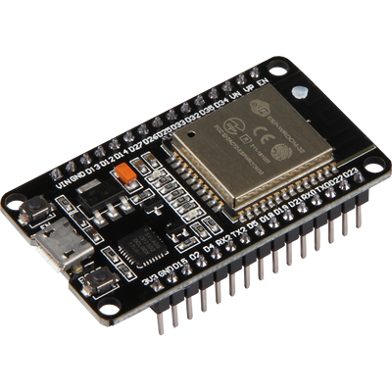
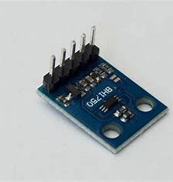
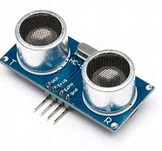
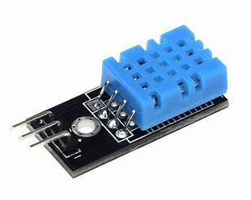
COMPONENTS USED
ESP-WROOM-32
WiFi-Bluetooth Module
BH-1750
Light sensor
Ultrasonic sensor
DHT-11
Temperature & Humidity sensor
Good for 20-80% humidity readings with 5% accuracy.
Good for 0-50 °C temperature readings +/-2°C accuracy.
Low Resolution Mode: 4lx.
Has a light noise rejection function of around 50Hz to 60Hz.
Ranging Distance : 3cm – 350cm.
Resolution: 1cm.
Measuring angle: 15°

Slide 5
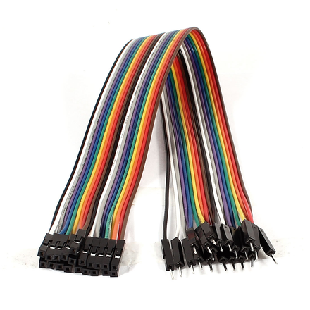
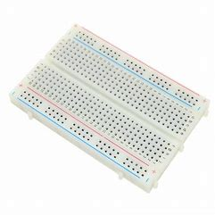
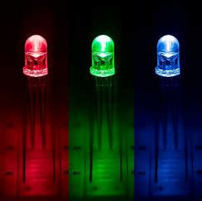
Jumper Wires
Breadboards
LEDs

Slide 6
BLOCK DIAGRAM
Temperature and humidity sensor(DHT-11)
Ultrasonic
sensor
ESP-32
Light sensor
(BH-1750)
Blynk App

Slide 7
SMART STUDY ENVIRONMENT SETUP:
By using BH-1750 sensor we are measuring the light intensity of the classroom and thus providing the effective light setup in order to set up the proper study environment.
The DHT-11 sensor is used in order to measure the room temperature as well as humidity and report it to the user for proper setup.
The Ultrasonic sensor is used to measure the proximity of the person entering the classroom and adjust the intensity of the light accordingly. This information is then reported to the database from the setup.
We aspire to create an app through which the light conditions can be easily set according to the needs of the students.

Slide 8
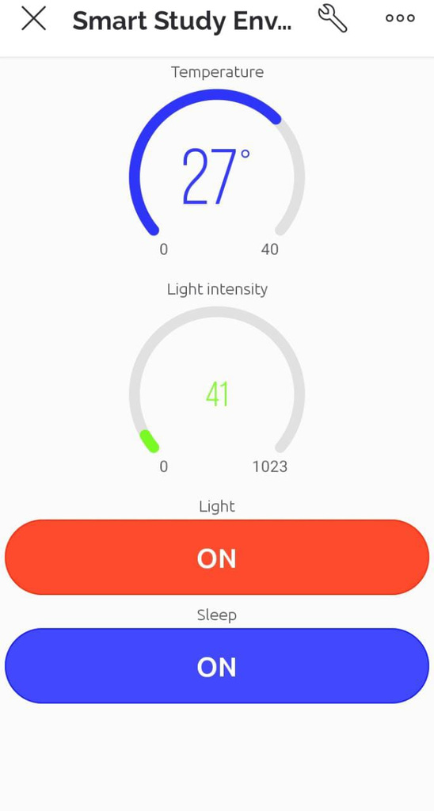
BLYNK APP

Slide 9
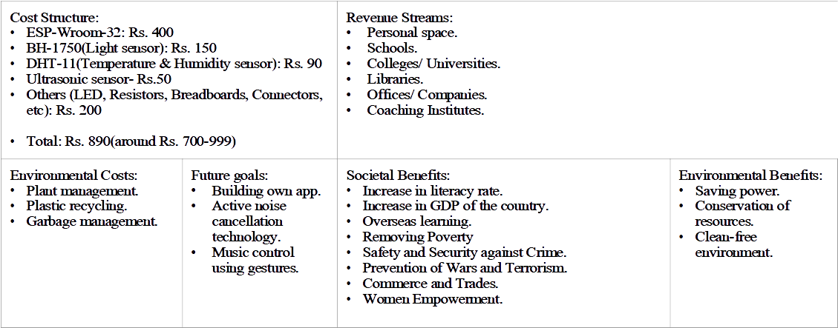
BUSINESS MODEL

Slide 10
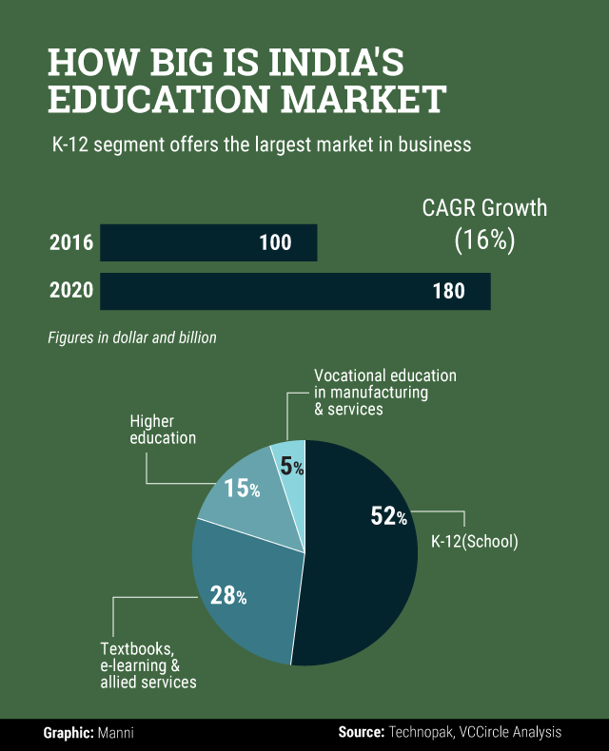

Slide 11
Thank you

